Slide 1
Laravel Certificate Course
NAME : NITYA PATEL
ENROLLMENT NO : 23000042
SYBCA-B-Batch
CMP304

Slide 2
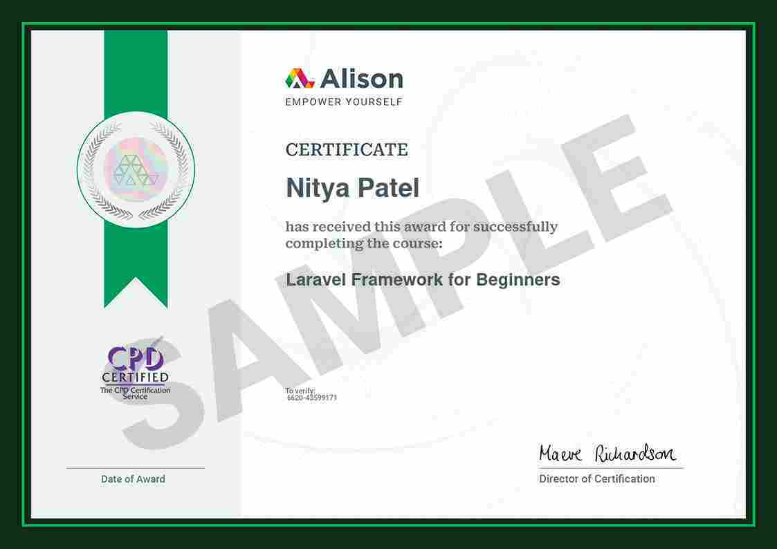

Slide 3
Contents
01
02
03
04
05
06
Introduction to Laravel
Understanding MVC in Laravel
Setting Up Laravel
Building a Simple Web Application
Advanced Laravel Features
Best Practices and Resources

Slide 4
Introduction to Laravel
01

Slide 5

What is Laravel?
Developer Empowerment
By integrating key features, Laravel allows developers to focus on unique application aspects, fostering creativity.
Strengths of Laravel
It provides a rich repository of pre-built components, speeding up development and facilitating robust applications.
Purpose and Goals
Laravel aims to streamline development with an elegant syntax, minimizing complexity in routine tasks.

Slide 6

Benefits of Using Laravel
01
Scalability and Maintainability
Following MVC architecture promotes code organization and allows for easier scalability and maintainability.
02
Extensive Ecosystem
Laravel has numerous packages catering to various needs, from authentication to complex API integrations.
03
Community Support
A vibrant community offers forums, tutorials, and resources that assist developers in finding solutions and best practices.

Slide 7
Understanding MVC in Laravel
02

Slide 8



Significance of MVC
01
02
03
Separation of Concerns
Code Reusability
Testing Support
MVC promotes distinct roles for Models, Views, and Controllers, enhancing code structure and readability.
Each MVC component can function independently, allowing for efficient code reuse and reduced duplication.
The separation facilitates unit testing of individual components, ensuring functionality across the application.

Slide 9



Practical Examples of MVC
01
02
03
Model Example
View Example
Controller Example
An example of a Model in Laravel using Eloquent ORM showcases how data manipulation is handled.
A Blade template example illustrates how presentation logic is integrated into user profiles effectively.
The Controller example demonstrates how application flow is managed in a structured way.

Slide 10
Setting Up Laravel
03

Slide 11


Installation Process
System Requirements
Installation Steps
Laravel requires PHP, Composer, and certain extensions; knowing these is vital for successful installation.
Step-by-step instructions on how to install Laravel via Composer and set up the project directory structure.

Slide 12


Initial Configuration
Environment Setup
Directory Structure Overview
Configuring the .env file is essential for database connections and setting application environment variables.
Understanding the Laravel directory structure helps in navigating and organizing project files effectively.

Slide 13
Building a Simple Web Application
04

Slide 14


Application Blueprint
Defining Project Scope
Wireframing
Determine the features and functionality required for the web application before development begins.
Create wireframes to visualize the application's layout, ensuring logical flow and user experience considerations.

Slide 15
Development Phase
Creating Routes
Learn how to define routes to direct traffic and organize application functionality logically.
Building Controllers
Designing Controllers to manage requests and handle data will be crucial for application performance.

Slide 16
Advanced Laravel Features
05

Slide 17
Authentication and Authorization
Setting Up Authentication
Role-based Access Control
Implementing user login and registration procedures using Laravel's built-in features and security measures.
Understanding how to manage user permissions and roles to secure application functionality effectively.

Slide 18



Working with APIs
API Authentication
Learn methods for securing APIs, including token-based authentication and access control techniques.
Creating APIs
Steps to develop RESTful APIs with Laravel, facilitating data exchange between client and server.

Slide 19
Best Practices and Resources
06

Slide 20


Laravel Best Practices
Code Organization
Testing and Debugging
Best practices for maintaining a clean codebase through proper organization and adherence to coding standards.
Techniques for effective testing and debugging to ensure application reliability and performance optimization.
01
02

Slide 21
Learning Resources
01
02
Documentation and Tutorials
Community Engagement
Leveraging official documentation, online courses, and community resources for continuous learning and improvement.
Importance of participating in forums and community events to stay updated and grow as a Laravel developer.

